Slide 1
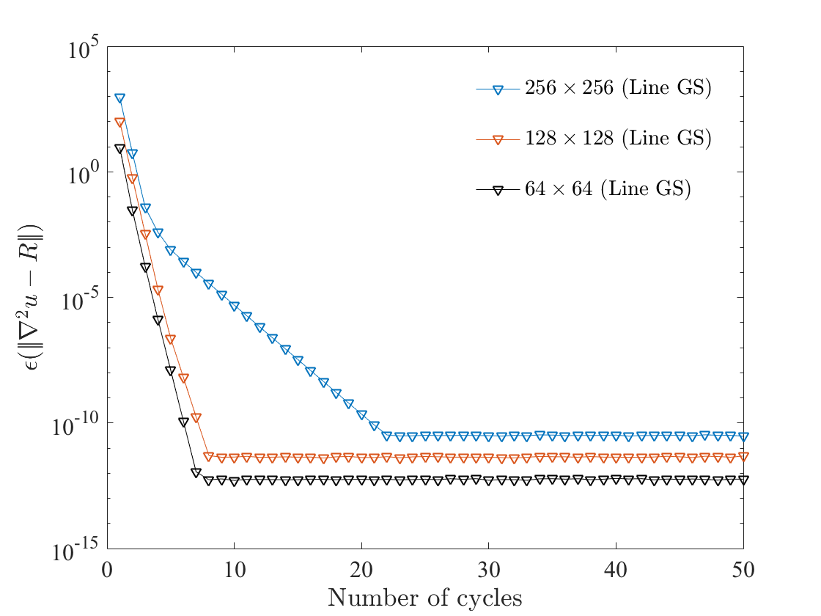
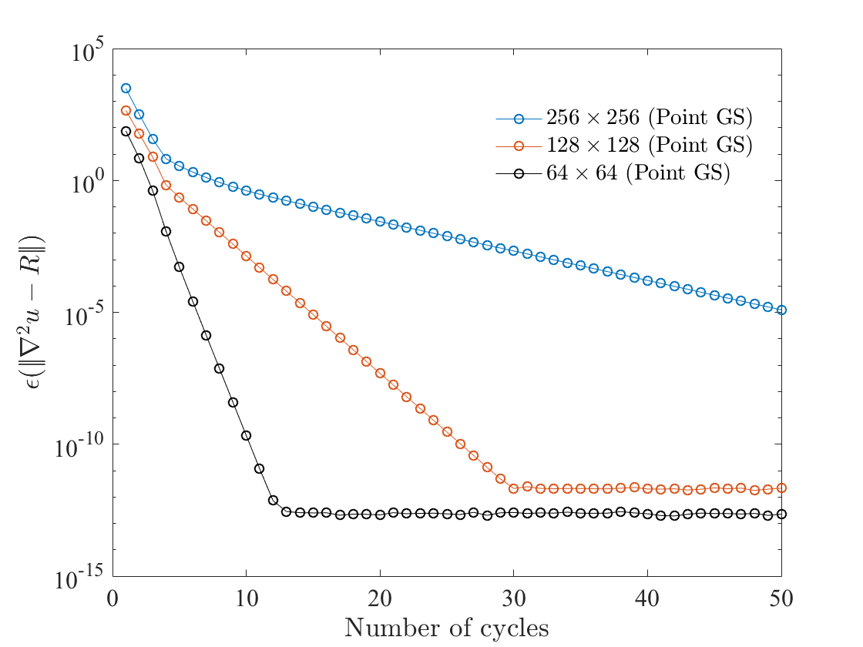

Slide 2
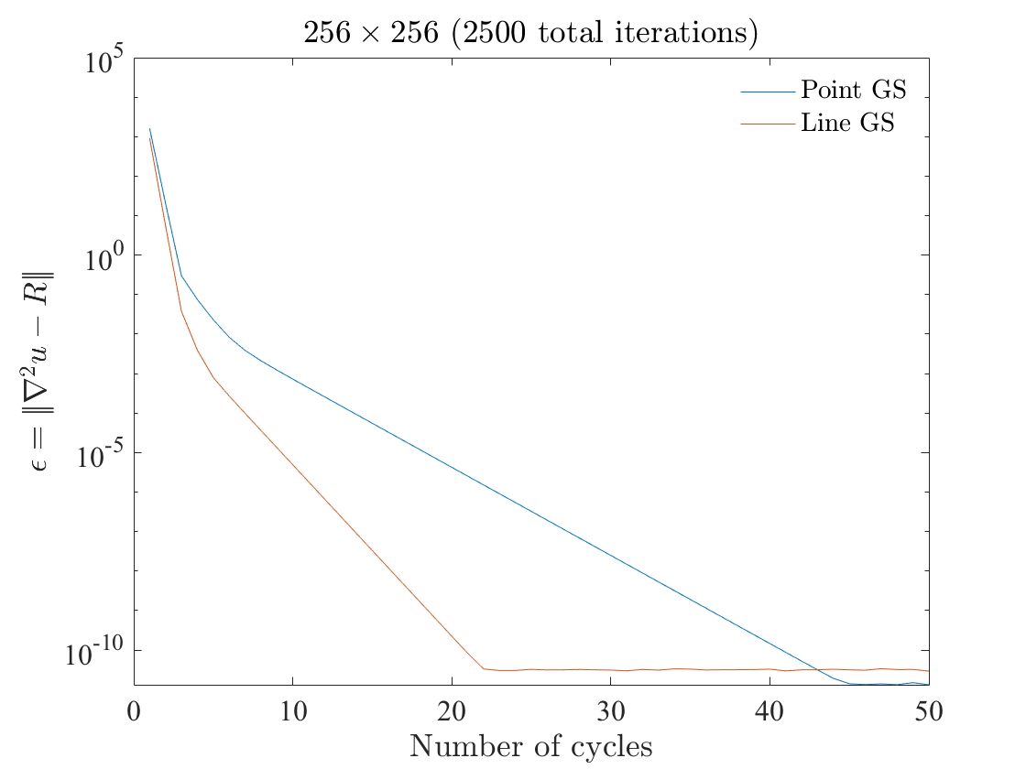

Slide 3
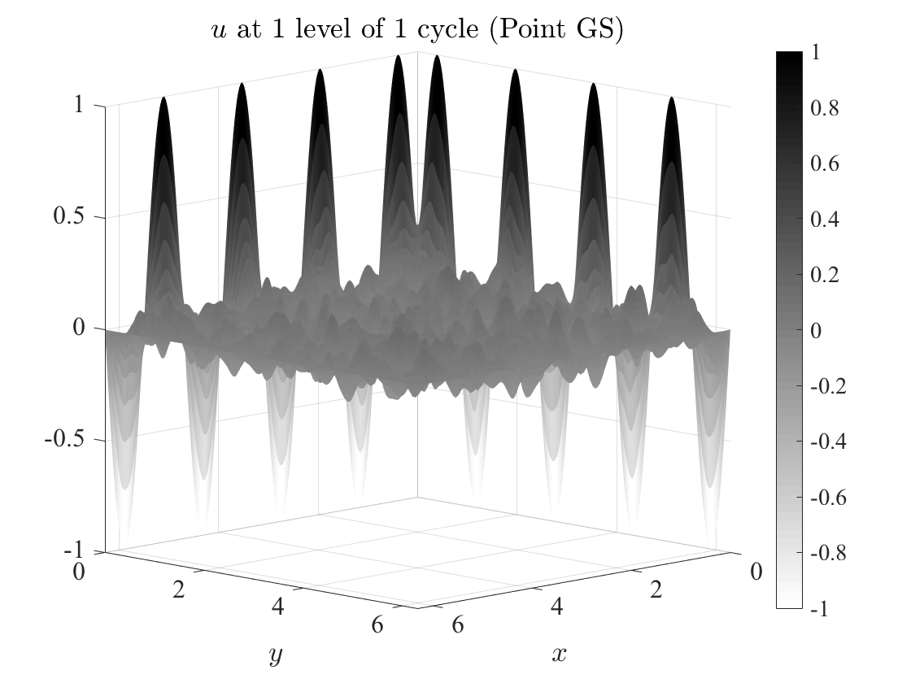
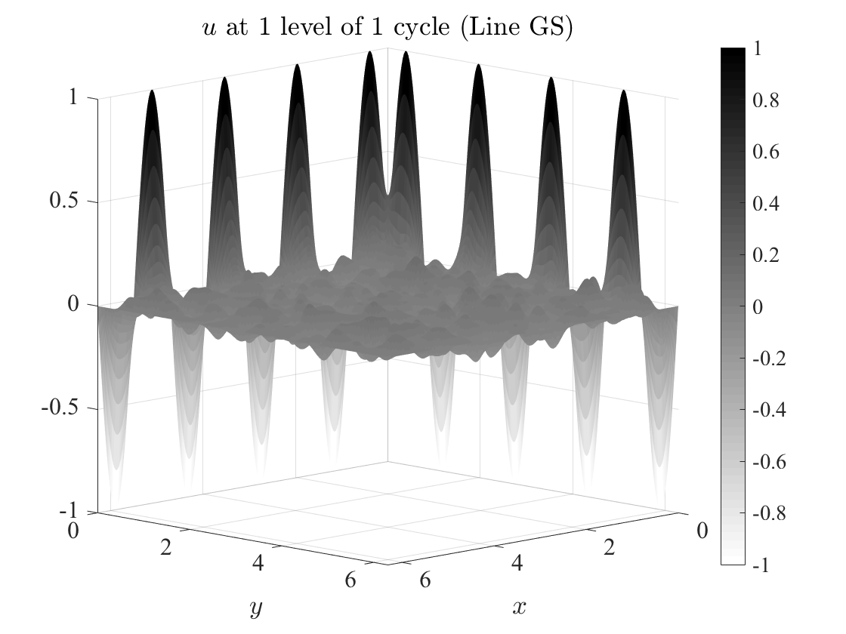
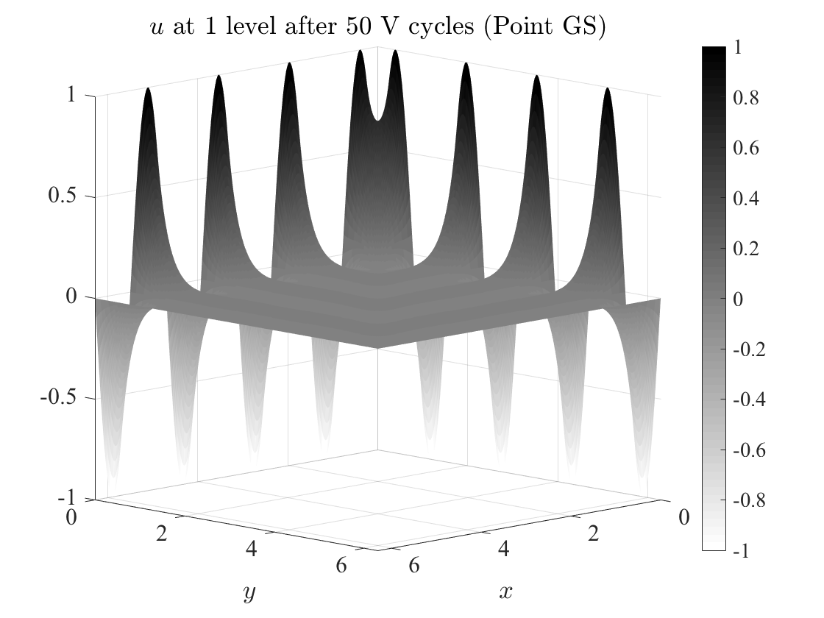


Slide 4
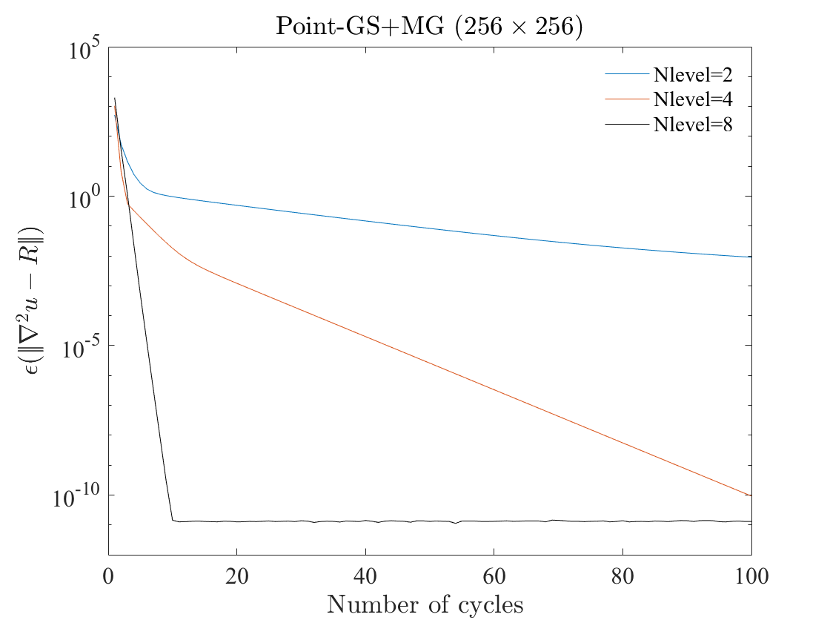
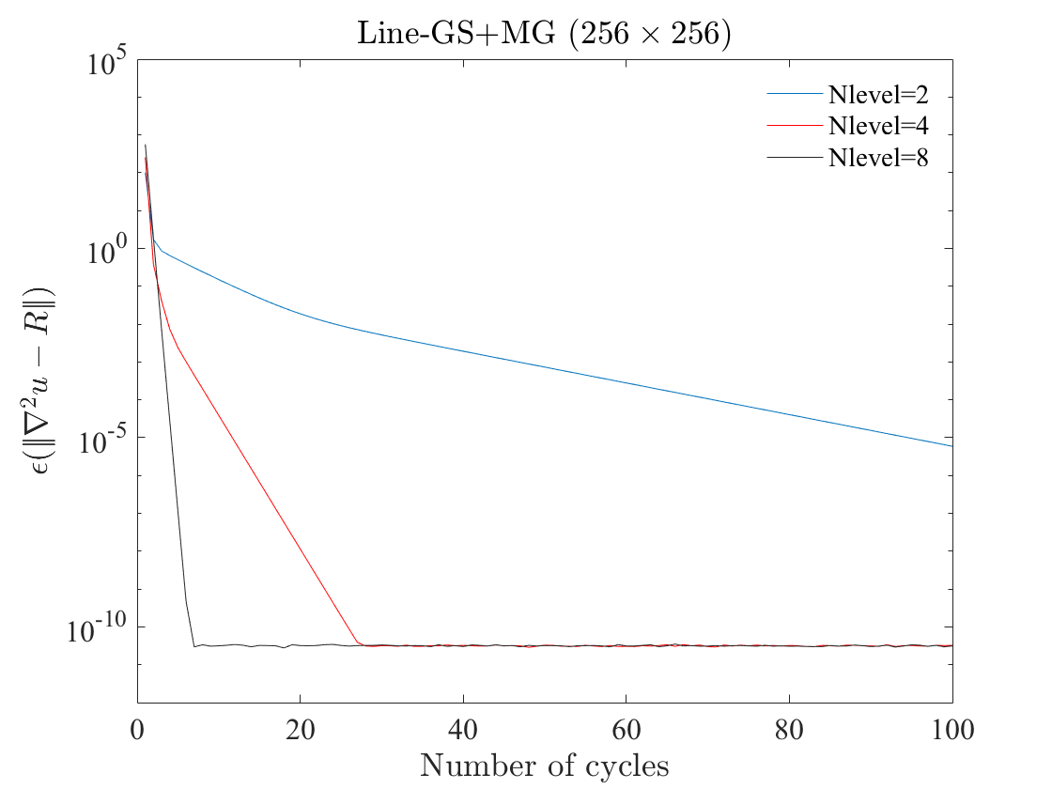

Slide 5
Generate grids for all levels
Ncycle > limit
Analysis
Initialize arrays with BC
Fine to Coarse: Restriction
Ncycle < limit
Find coefficient matrices
V-cycle
W-cycle
Coarse to fine: Prolongation
Ncycle > limit
Ncycle < limit
Analysis
Fine to Coarse: Restriction
Coarse to fine: Prolongation
Coarse to fine: Prolongation
Fine to Coarse: Restriction

